Slide 1









The AddICTIVE FEATURES OF MOBILE GAMES
Shreya ThothathrI

Slide 2





AGENDA
01.
02.
03.
Focus Activity
Puzzle Games
Idle Clickers
Discussion

Slide 3

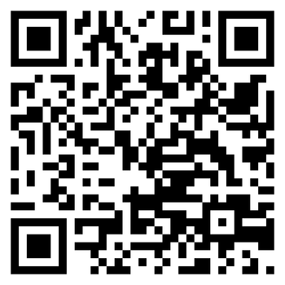



ActIVITY
https://forms.gle/My2AmMEEokeGfy5k7

Slide 4






Puzzle Games
What are some ways puzzle games Keep Players engaged longer?
A. Hook
B. Reinforcement
C. Social Aspect

Slide 5


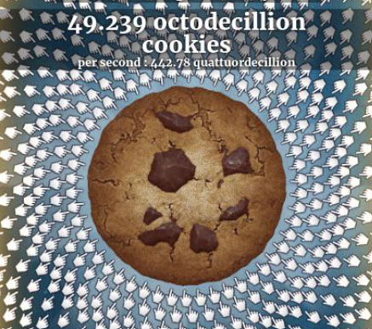
IDLE ClICKERS
01.
02.
03.
Click
Automate
REpeat

Slide 6
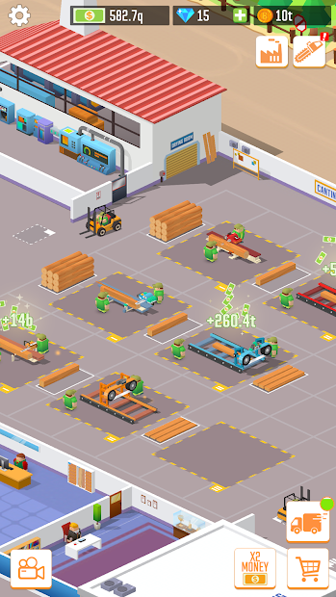
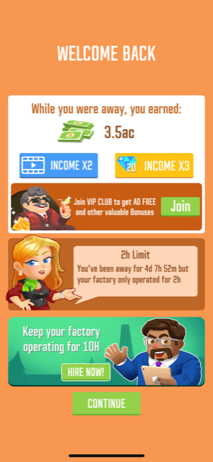
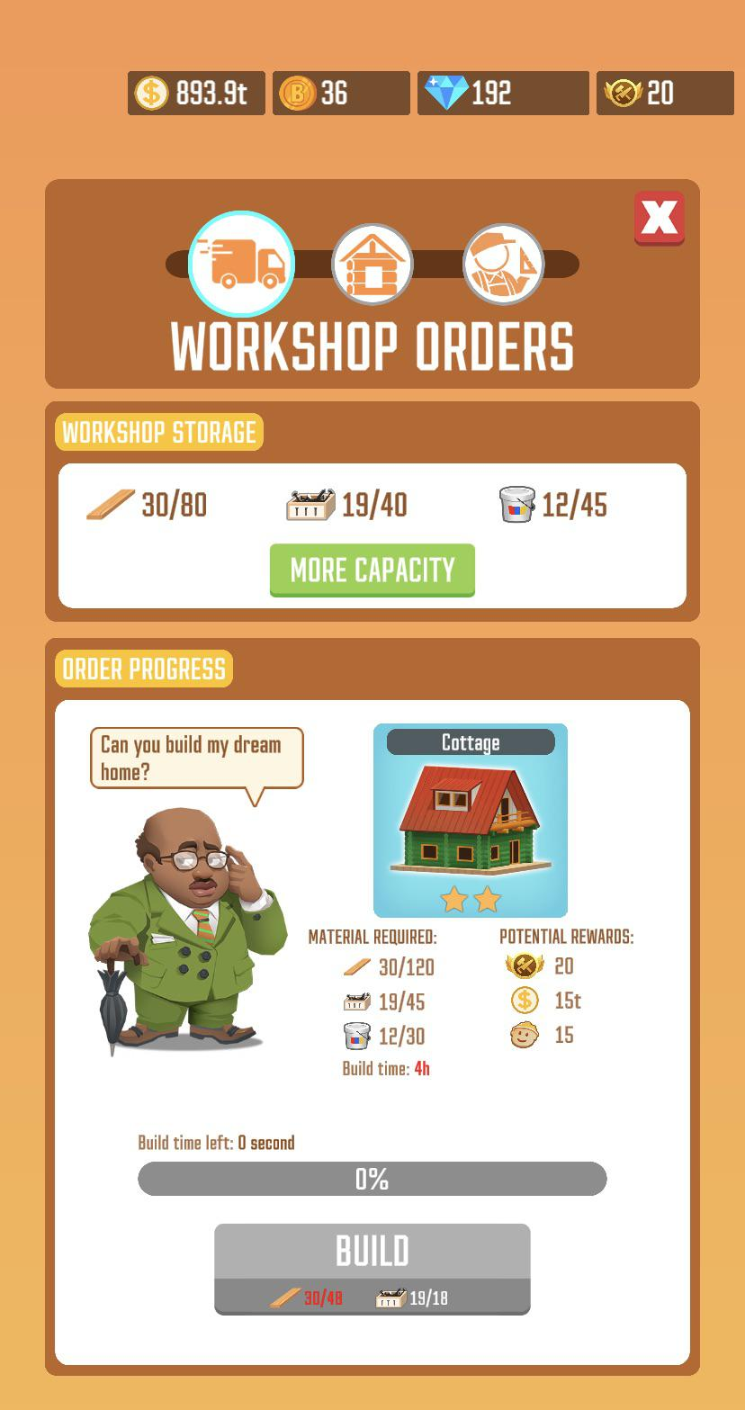
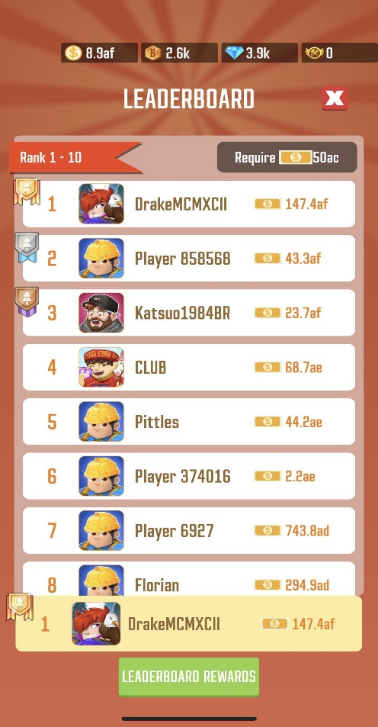
IDLE ClICKERS
01.
02.
03.
02.
Recurring Gratification
Rewarded On Return
Interpassivity
Social Interaction

Slide 7
Question No.1
When Designing Mobile Apps, where is the Boundary between engaging the user and Addicting them to a game? What are some Ways Developers can protect Users from Getting too Hooked into Mobile Games?
Notes:
When it uses things that gambling places use

Slide 8



question No.2
How can these Strategies to Increase Player engagement be used for Good?
Notes:
https://dl.acm.org/doi/fullHtml/10.1145/3490099.3511114

Slide 9


Thank you for LIstenIng

